Slide 1
Stonecroft Subdivision
HOA Meeting - 2021
September 16th
Board of Directors
John Rhomberg (term ends 2021)
Jason Valvero (term ends 2022)
Becky Pogorzelski (term ends 2023)
www.stonecroftsubdivision.com
StonecroftSubdivision@gmail.com

Slide 2
Agenda
Call to Order
Recap from last meeting
Board Updates
Treasurer’s Report
Voting Update
Open Forum
Adjourn Meeting

Slide 3
Last Meeting
Last’s year meeting was held at Veteran’s Memorial Park.
We had 10 homeowners represented at the meeting last year.
Election - Jason Valvero’s term was renewed for another 2 years and Becky Pogorzelski was elected for a three year term.
Jason’s term ends Sept 2022
Becky’s term ends Sept 2023
Newly elected term will end Sept 2024

Slide 4
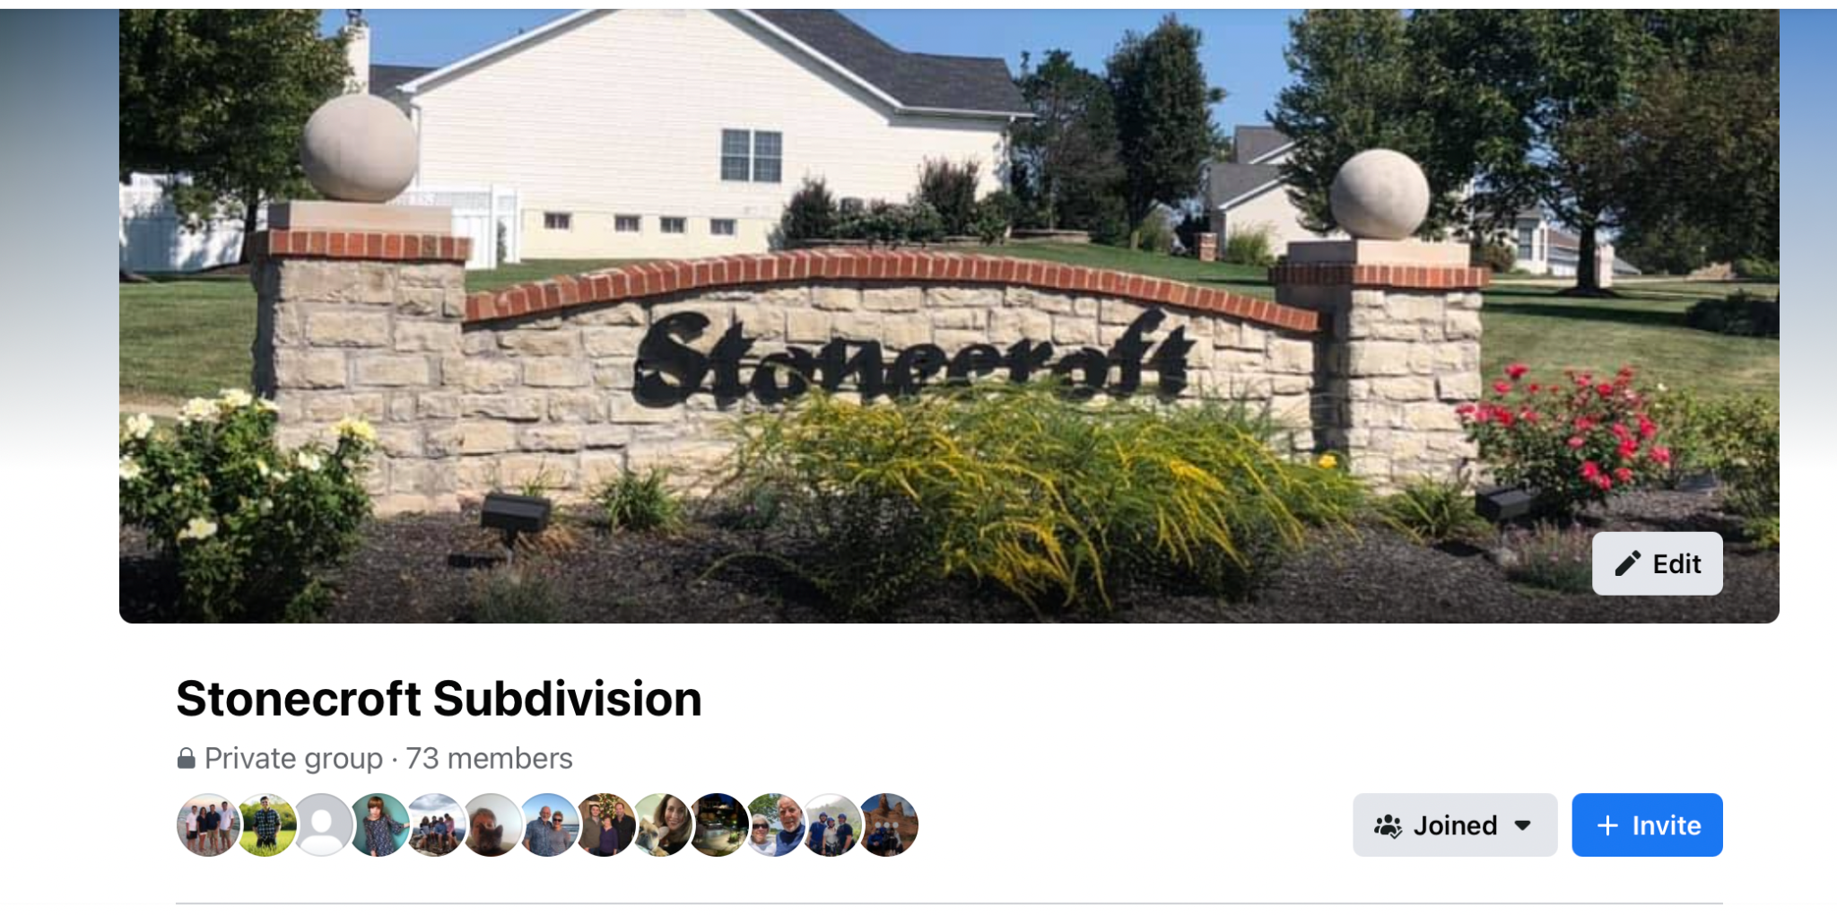
Join us on Facebook…...invite your neighbors!

Slide 5
Board Updates
2021 projected expenses to be less than dues collected. We still have a few projects that would like to get completed prior to year end.
Guard House - infested with termites and will need to have treated to remove infestation. Will be removing drywall and spraying the interior. In addition, will need to replace trim around door and do some painting.
Monument - Need to trim back the crabapple trees and the center island trees as they are getting too large for the area.
Common Ground - Have several stumps that need to be removed and trees replaced. Would like to plant pine trees along Kisker road where there is no fence.
Instances of trailers parked in driveways for extended periods of time. We are in the process of sending notices and will move to fines if not addressed.
Stonecroft Garage Sale - October 2nd

Slide 6
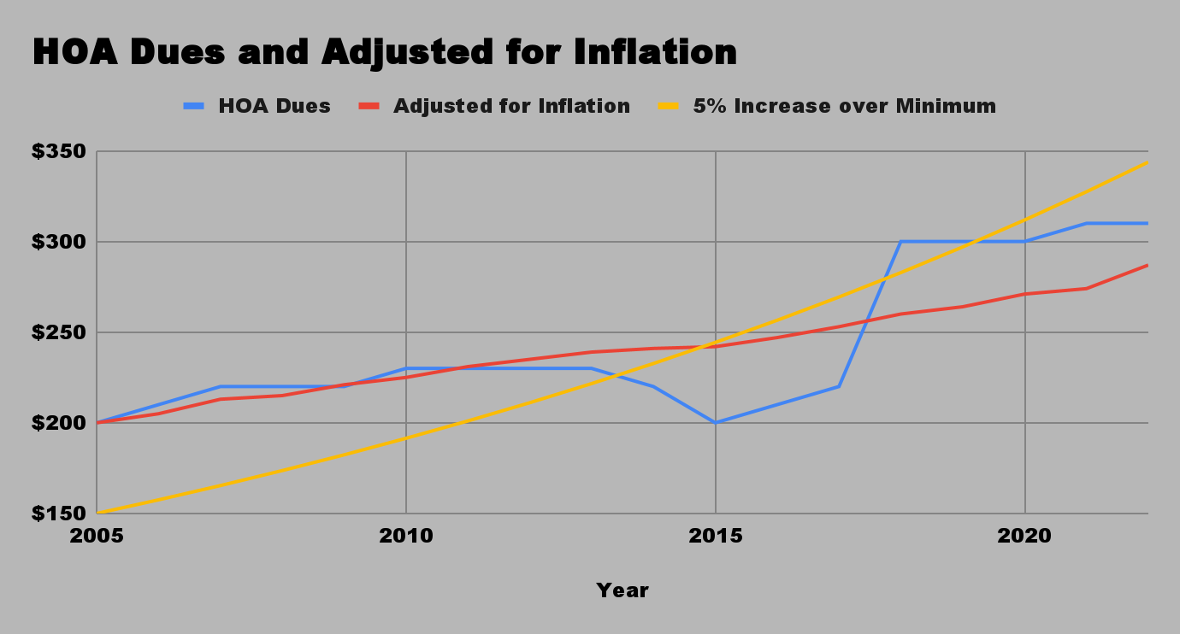
HOA Dues
No increase in dues for 2022. We will maintain the current rate of $310.
2022 Budget:
Annual Assessments $45,260
Lawn - $20K
Mgmt Fees - $6K
Electricity/Water - $6K
Insurance - $3K
Tree Care/Landscaping - $5K
Other - $2K
Contingency - $3,260
If dues were adjusted for inflation since 2005, current dues would be $287
If dues were increased 5% each year over base as allowed in the by laws, current dues would be $344

Slide 7
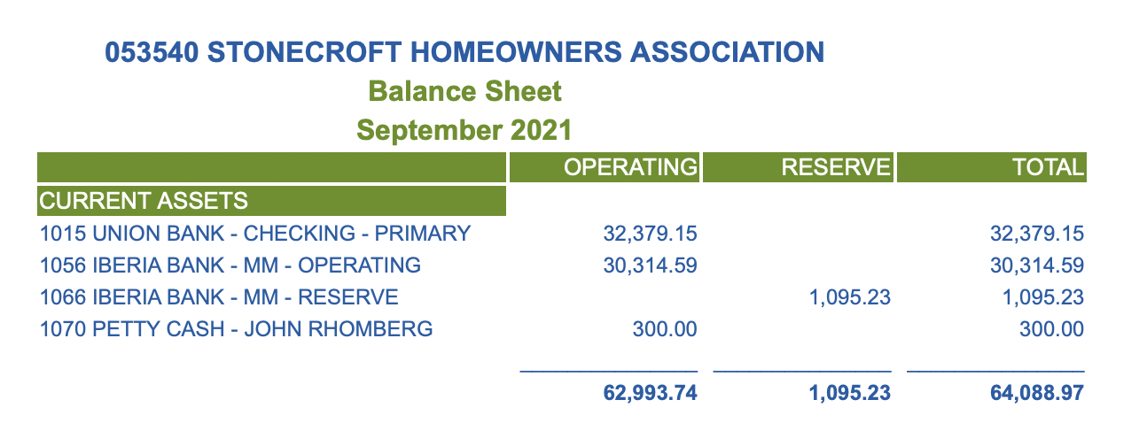
Treasurer’s Update
Balance Sheet currently has $64K in Union Bank and Iberia Bank
Sept - Dec outstanding expenses are expected to be around $10K - $12K.
Expected Year End cash balance of $52K compared to last year of $49K
2021 Dues were $43.8K and we are forecasting expenses of $42K. We still have 3 homeowners that owe dues partially offset by $800 in closing fees collected.
Will have additional expenses for termite control and work at guard house.

Slide 8
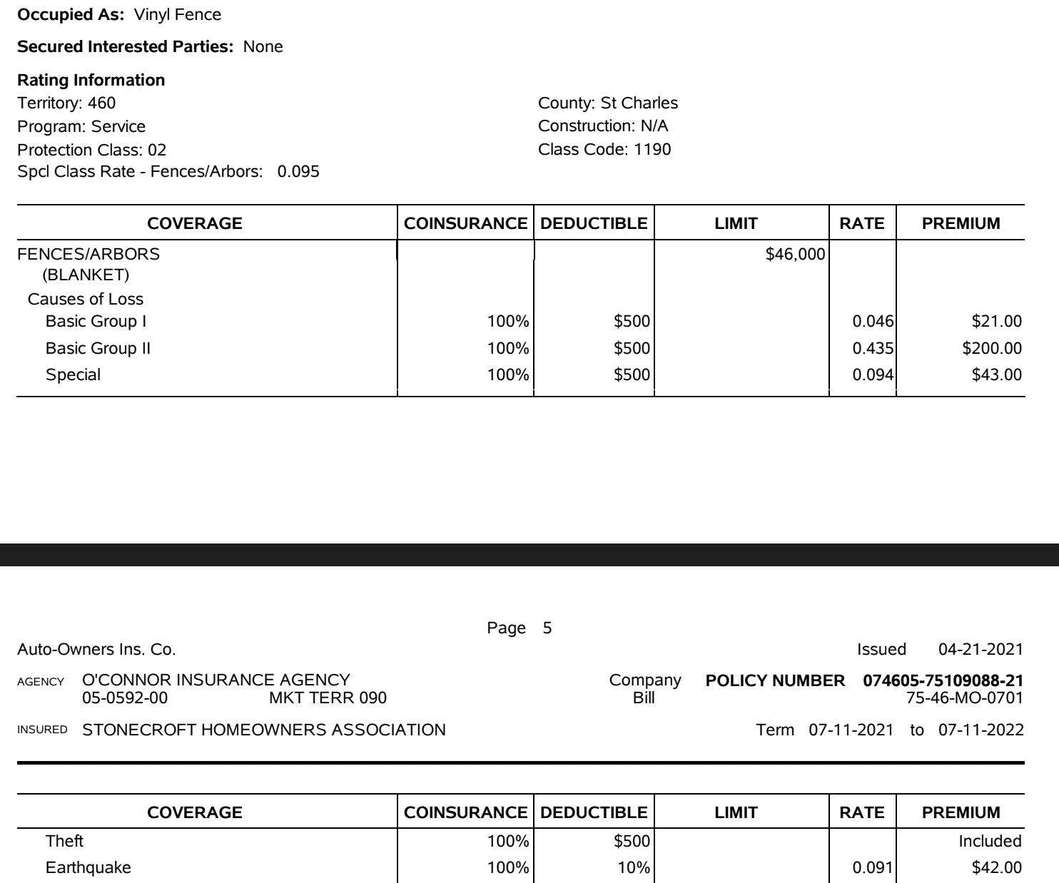
Stonecroft Fence
Annual cost of insurance for the Stonecroft Fence is $306/yr.
There was no money spent on maintenance this year. Last year we incurred approximately $500 due to several issues related to vandalism and the lattice breaking in areas.
Cost for each homeowner is approximately $5/yr.
We are committed to maintaining the fence to protect the neighborhood and keeping the appearance of the neighborhood looking nice.
There are no plans to replace it any time soon, however, we do have a few sections that are in need of replacement cross bars or lower sections.

Slide 9
Voting
Information about the Candidates:
Pam Erickson: I have been a resident for 16 years, recently retired and now that I have the time, want to give back to my community and help Stonecroft stay the great area to live in, as it has been for all these years. I believe in transparency and will work hard to be available to every homeowner to answer questions and help with any issues they may have. As we are seeing more new homeowners moving into our subdivision, I would like to form a welcoming committee, to give them information about our homeowner's association and to make sure they have a copy of our subdivision indentures, answer any questions they may have, and invite them to follow us on facebook or look us up on our website. My work background was in business management and accounting. John Rhomberg: I've been a resident of Stonecroft since 2018 and a board member since that time. My wife and I always wanted to live in Stonecroft and waited for the right time to move. There are so many great things about the neighborhood that made this a great fit for our family. We have 2 boys, one in High School and the other attending Missouri S&T. I'm a licensed CPA and currently serve as VP of Finance. I take pride in ensuring that neighborhood is taken care of and can be seen out regularly pulling weeds, cutting grass in the retention basin or trimming trees that have fallen or gotten too big. If I'm not doing that, we are out walking the dog visiting with the neighbors and keeping an eye on things. Over the last several years, we've started the Facebook site, streamlined the website and worked with the vendors to cut cost where possible. I would like the opportunity to serve another 3 years to see what more we can accomplish.
If you have not voted and would like to vote now, please do so via ballots provided.

Slide 10
Open Forum
Introduction of homeowners for anyone new to the neighborhood.
Please raise your hand if you have a question. If there is a question that can not be addressed during the meeting or requires additional discussion among the board, we reserve the right to take the question and get back to you with an answer at a later time.
Thank you!

Slide 11
Meeting Adjourned
Thank you for your interest in the neighborhood and for attending the meeting.

