Slide 1
Stonecroft Subdivision
HOA Meeting - 2022
September 22nd
Board of Directors
John Rhomberg (term ends 2024)
Becky Pogorzelski (term ends 2023)
Jason Valvero (term ends 2022)
www.stonecroftsubdivision.com
StonecroftSubdivision@gmail.com

Slide 2
Agenda
Call to Order / Introductions
Recap from last meeting
Board Updates
Treasurer’s Report
Voting Update
Open Forum
Adjourn Meeting

Slide 3
Introductions
Name
Address
How long have you lived in Stonecroft?
How many kids / dogs do you have?
What do you like best or least about the neighborhood?

Slide 4
Last Meeting
Last’s year meeting was held at Kisker Library
We had 12 homeowners represented at the meeting last year.
Election - John Rhomberg was re-elected to another term of 3 years
Jason’s term end 2022
Becky’s term end 2023
John’s term will end 2024
Request to post Financial Statements to website has been addressed.
Home with pallet in front yard was addressed.
Electrical panel at front of neighborhood is still pending. Waiting to see if we need to redo berms around electric meter.
Bob Baker sprinkler information has been shared on website.

Slide 5
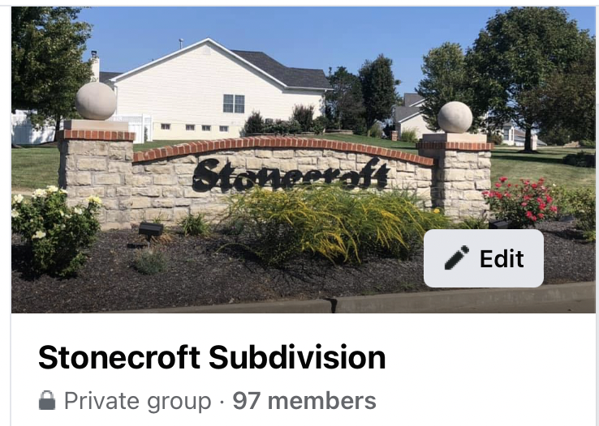
Join us on Facebook…...invite your neighbors!

Slide 6
Board Updates
2022 projected expenses to be less than dues collected. We still have a few projects that would like to get completed prior to year end.
Guard House - Was treated for termites this year as it was infested. Now that the termites appear to be under control, need to replace the trim around the door and repaint.
Monument - Will be working to trim back the crabapple trees and replant a few bushes.
Common Ground - We’ve had to cut down approximately 10 dead pine trees throughout the neighborhood. There are some remaining stumps still to be removed. In addition, we will be planting some evergreen trees in some of the areas of the common ground.
Working to find lawn care company to contract with for next year’s services. Current contract expires in November. In addition, we will find separate company to fertilize and treat common ground at the entrance to the subdivision.
Stonecroft Garage Sale - held on September 17th - Thanks to Norm for supporting and for the donuts!
Sentry Managment - We have a new Community Association Manager at Sentry Management. HIs name is Tyler Mazdra and can be reached @ 636-970-1887 Ext. 57608 or stcharles.sentrymgt.com

Slide 7
Treasurer’s Update
Balance Sheet currently has $76K in Pacific Western Bank.
Sept - Dec outstanding expenses are expected to be around $8K.
Expected Year End cash balance of $68K compared to last year of $67K.
We currently have 3 homeowners that have not paid their dues. Of those 3, we have liens on 2 of the houses.

Slide 8
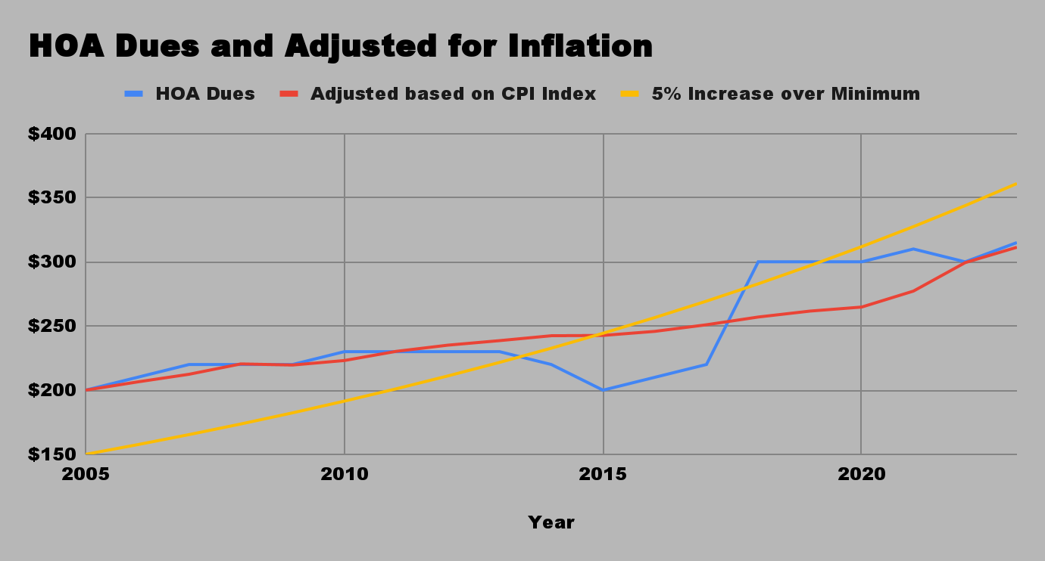
HOA Dues
HOA Dues:
2021 - $310
2022 - $300*
2023 - $315
*error by Sentry sending out wrong assessment amount
2023 Budget:
Annual Assessments $45,990
Lawn care / Fertilization - $25K
Mgmt Fees - $7K
Electricity/Water - $6K
Insurance - $4K
Tree Care/Landscaping - $3K
Other - $1K
If dues were adjusted for inflation since 2005, current dues would be $311
If dues were increased 5% each year over base as allowed in the by laws, current dues would be $361

Slide 9
Voting
Information about the Candidates:
Jason Valvero: Current board member and active member of the Stonecroft neighborhood.
Lived in two houses within the subdivision.
Wife (29 years old) and daughter (12 years old).
Love talking with the other members of the community.
Other Nominations:
Since we did not have any nominations prior to the meeting, we will be taking a vote now.

Slide 10
Open Forum
Please raise your hand if you have a question. If there is a question that can not be addressed during the meeting or requires additional discussion among the board, we reserve the right to take the question and get back to you with an answer at a later time.
Thank you!

Slide 11
Meeting Adjourned
Thank you for your interest in the neighborhood and for attending the meeting.

