Slide 1
Stonecroft Subdivision
HOA Meeting - 2023
September 21st
Board of Directors
Becky Pogorzelski (term ends 2023)
John Rhomberg (term ends 2024)
Jason Valvero (term ends 2025)
www.stonecroftsubdivision.com
StonecroftSubdivision@gmail.com

Slide 2
Agenda
Call to Order / Introductions
Recap from last meeting
Board Updates
Treasurer’s Report
Voting Update
Open Forum
Adjourn Meeting

Slide 3
Introductions
Name
Address
How long have you lived in Stonecroft?
Favorite restaurant
Favorite place to vacation

Slide 4
Last Meeting
Last’s year meeting was held at Kisker Library
We had 7 homeowners represented at the meeting last year.
Election - Jason Valvero was re-elected to another term of 3 years
Becky’s term ends 2023 (Today)
John’s term ends 2024
Jason’s term end 2025
Discussed increase to dues from $300 to $330 for FY23.
Discussed areas of common ground that needed attention.
Road repairs were started and finished last year.

Slide 5
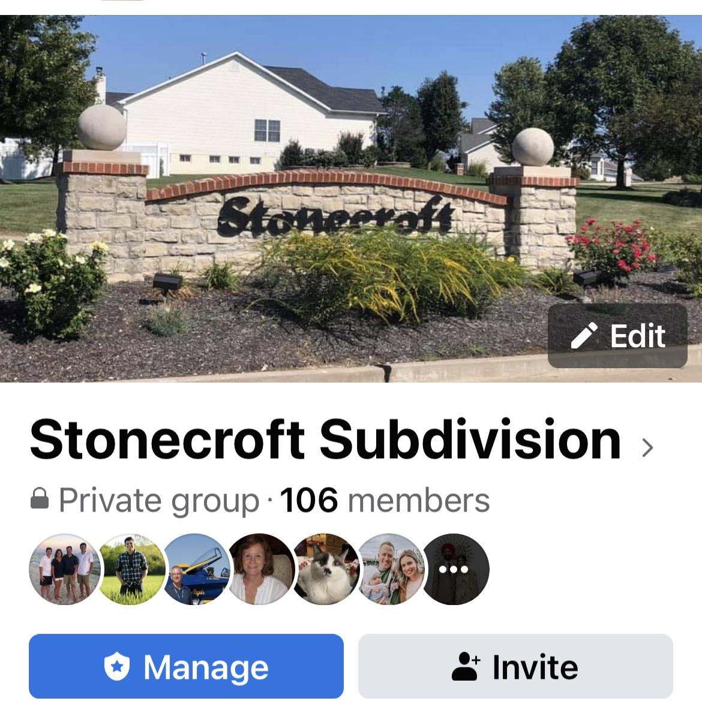
Join us on Facebook…...invite your neighbors!

Slide 6
Board Updates
2023 projected expenses to be less than dues collected. We still have a few projects that would like to get completed prior to year end.
Guard House - Will be looking to replace trim around door and paint.
Monument - Trimmed back the crabapple trees and planted a few new bushes around monument. Will need to replace the rose bushes in the near future.
Common Ground - Amazingly only a couple small tree clean-ups this year after the wind storm this summer. There are a few dead trees we need to have removed this winter behind Country Park Circle. Evergreens were planted in the common ground behind Hesters Way to replace some of the damaged pine trees.
Contracted with Cut Rate lawn care for this year and next year. We are separately having the monument area fertilized by Tennant lawn care which is doing a great job keeping the lawn green.

Slide 7
Board Updates (continued)
Stonecroft Garage Sale - Norm is sponsoring a second garage sale on October 7th.
Sentry Management - We signed a new agreement with Sentry Mgmt this year that is an “Accounting only” agreement. They will provide financials, handle bank accounts, collect dues, pay vendors and file and liens. They will not be doing drive throughs. This keeps our rates lower with no increase.
Online Architectural Request form is now available on the website
https://www.stonecroftsubdivision.com/architectural-request-form.html
Please complete this form PRIOR to starting any projects that would need approval

Slide 8
Treasurer’s Update
Balance Sheet currently has $86K in Pacific Western Bank compared to $76K at this time last year.
Sept - Dec outstanding expenses are expected to be around $15K.
Expected Year End cash balance of $71K compared to last year of $68K.
Currently, no homeowners are outstanding on dues.

Slide 9
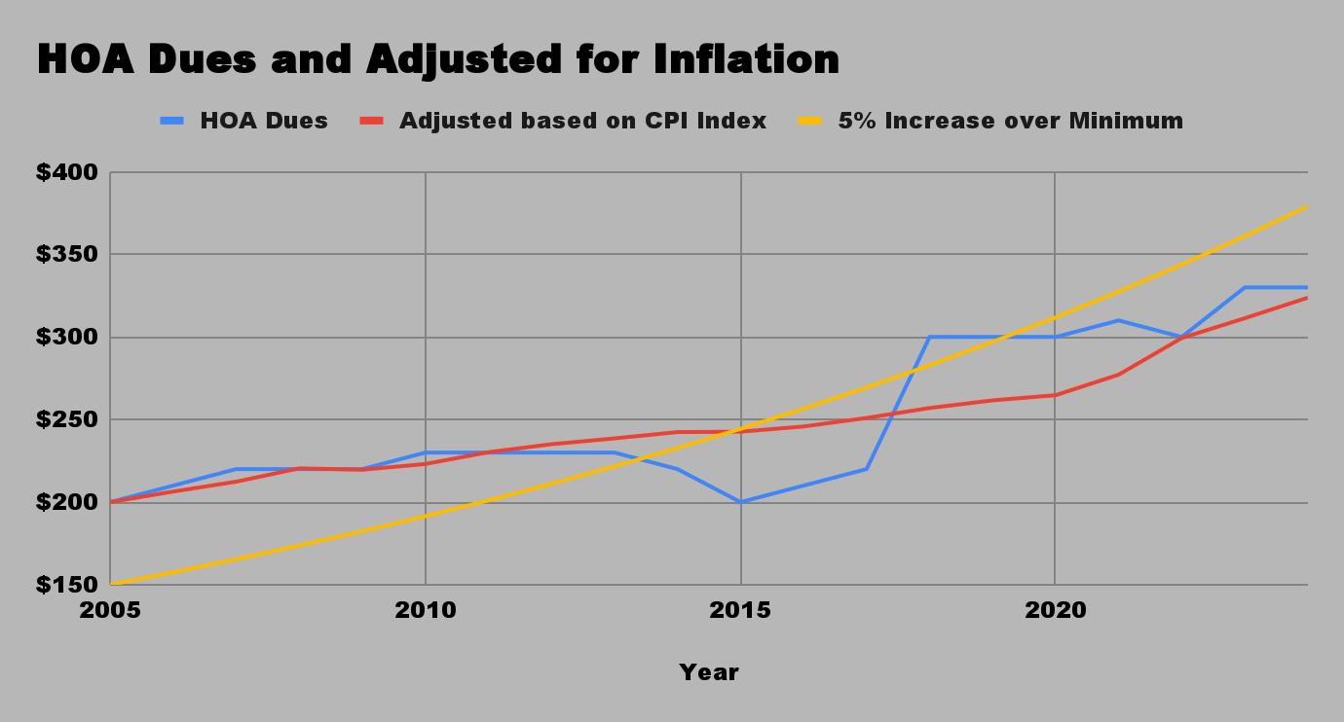
HOA Dues
HOA Dues:
2021 - $310
2022 - $300*
2023 - $330
2024 - $330
*error by Sentry sending out wrong assessment amount
2024 Budget:
Annual Assessments $48,180
Lawn care / Fertilization - $25K
Mgmt Fees - $7K
Electricity/Water - $6K
Insurance - $4K
Tree Care/Landscaping - $4K
Other - $2K
If dues were adjusted for inflation since 2005, current dues would be $324
If dues were increased 5% each year over base as allowed in the by laws, current dues would be $379

Slide 10
Voting
Information about the Candidates:
Becky Pogorzelski: Married to Dave Pogorzelski
Current board member and active member of the Stonecroft neighborhood.
Retired pharmacist from Express Scripts
Volunteer at Five Acres Animal Shelter and many other charities
Other Nominations:
Since we did not have any nominations prior to the meeting, we will be taking a vote now.

Slide 11
Open Forum
Please raise your hand if you have a question. If there is a question that can not be addressed during the meeting or requires additional discussion among the board, we reserve the right to take the question and get back to you with an answer at a later time.
Thank you!

Slide 12
Meeting Adjourned
Thank you for your interest in the neighborhood and for attending the meeting.

